Slide 1
NEGOTIATION SKILLS
William A. Burgess, SIOR, CCIM
The Burgess Company, LLC
Greenville, SC

Slide 2
What we will cover:
Defining the Negotiation Process
Critical Variables
Preparation “Secrets”
Time as a “Game Changer”
Negotiating Strategies and Counter-Strategies
Class Case Study Negotiations

Slide 3

What Is Negotiating?
“NEGOTIATIONS” IS A PROCESS!

Slide 4
Webster’s Dictionary Definition
Negotiate: “to settle or conclude a transaction. To transfer or sell. To succeed in crossing, moving through, etc.”
Negotiation: “conferring or bargaining to reach an agreement.”

Slide 5
Key Elements of the Negotiation Process
The starting point
There may be more than one party
Are there any conflicts of interest?
“Give and Take”
It is a voluntary relationship
Notes:
5
SIOR Negotiation Skills

Slide 6
Approaches to Negotiation
Approach
to come near or nearer to
to begin work on; set about:
Notes:
6
SIOR Negotiation Skills

Slide 7
Approaches to Negotiation
Distributive Negotiation
  Positional bargaining, i.e. “this is my position and you can try and bargain me down from it”
  It’s the “fixed pie” mentality, and I’m going to grab the biggest piece of the pie that I can possibly grab
  Win/Lose strategy
Notes:
7
SIOR Negotiation Skills

Slide 8
Approaches to Negotiation
Integrative Negotiation
  Also known as interest-based bargaining
  It seeks mutual benefit for all that are involved
  “A rising tide raises all boats” – Reagan
  Win/Win strategy
Notes:
8
SIOR Negotiation Skills

Slide 9


Contemplating the
Spectrum of Negotiations
Integrative
Distributive
Notes:
9
SIOR Negotiation Skills

Slide 10
Negotiating is a Process
1. When does the process commence?
2. Exchanging ideas
3. Influencing your environment
4. Analyzing information/technical skills
5. No right answer: Patience is paramount
6. Online negotiations

Slide 11
The 9 Phases of Negotiation
The purpose of this section is to enable students to recognize the various phases and to help prepare students to handle each phase.
Notes:
11
SIOR Negotiation Skills

Slide 12
The 9 Phases of Negotiation
#1 Problem Identification
Define the problem in a form mutually acceptable to both sides.
  Letter of Intent (LOI)
  Request for Proposal (RFP)
Keep the problem statement as simple as possible
State the problem as a goal and identify the known obstacles to attaining that goal
Depersonalize the problem – don’t “blame” the other person
Separate the definition from the search for solutions
Notes:
12
SIOR Negotiation Skills

Slide 13
The 9 Phases of Negotiation
#2 Preparation
Understand the conflict situation
Decide what your team wants
Analyze the other side
Develop a strategy to help them make the decision you want
We will discuss various strategies later on in the course
Notes:
13
SIOR Negotiation Skills

Slide 14
The 9 Phases of Negotiation
#3 Entry
Need to be invited
Learn the authority of those with whom you negotiate
Start on a positive note
Establish or set control over procedure
Agree on ground rules, such as:
  Not to leave room without decision
  All agree that we are not leaving early
  All agree there are to be no outside interruptions
Notes:
14
SIOR Negotiation Skills

Slide 15
The 9 Phases of Negotiation
#4 Connecting with People
LISTENING!!!
Be courteous
Investing in people intentionally
Notes:
15
SIOR Negotiation Skills

Slide 16
Invest in People Intentionally
The 9 Phases of Negotiation
As you go into any relationship, think about how you can invest in the other person so that it becomes a win-win situation. Here is how relationships most often play out:
I win, you lose
- I win only once.
You win, I lose
- You win only once.
We both win
- We win many times.
We both lose
- Goodbye, partnership!
From How Successful People Think by John C. Maxwell
Notes:
16
SIOR Negotiation Skills

Slide 17
The 9 Phases of Negotiation
#5 Exploration or Probing
Educate yourself, then them
Fully explore and question, so as to gain understanding on all the issues, positions, and interests
The Five W’s and One H
Get them into the habit of saying “yes”
Keep the discussion on track, on the issues
Notes:
17
SIOR Negotiation Skills

Slide 18
The 9 Phases of Negotiation
#6 Inventing
Generate a range of alternative solutions
Draft and proffer possible agreements that are favorable to both sides
Notes:
18
SIOR Negotiation Skills

Slide 19
The 9 Phases of Negotiation
#7 Bargaining
Bargain for mutual enhancement rather than one-sided victory
How:
  Use reason
  Make it easier for them to decide what you’d like them to decide
Notes:
19
SIOR Negotiation Skills

Slide 20
The 9 Phases of Negotiation
#8 Closure
Don’t be pressured/don’t pressure
Summarize: Have both parties write a summary of what their understanding of the agreement is
Consider a trial close
Make the agreement operational
End on an affirmative, ceremonious note
Notes:
20
Instructor’s Note: Ask, “How do you feel?” “Do you feel comfortable the way this is structured?” “Are you ready to execute this?
SIOR Negotiation Skills

Slide 21
The 9 Phases of Negotiation
#9 Implementation
Action Plan
Support the agreement with the people you represent
Plan for the next negotiation
Notes:
21
SIOR Negotiation Skills

Slide 22
Preparation A: Know Yourself and the Other Party
Three primary areas to prepare to be an effective negotiator:
  Knowledge
  Communication Skills
  Attitude
Notes:
22
SIOR Negotiation Skills

Slide 23
Knowledge Preparation
What:
The root to negotiating
Requires research
Assess property
Benefit:
Allows positional evaluations
Allows you to have solutions
Allows you to set goals
Predict the other side
Anticipate the worst
Re-strategize during process
Notes:
23
SIOR Negotiation Skills

Slide 24
Knowledge Preparation
MOTIVATING FACTORS
Know the other side
Appeal to ego
Motivate human behavior
Notes:
24
SIOR Negotiation Skills

Slide 25
Knowledge Preparation
MOTIVATING FACTORS
What Tangibles are at Stake?
For Landlord:
  Income Stream/Return on Equity
  Appreciation
For Tenant:
  Space and Services
  Economic Cost Limits
  Quiet Enjoyment
Notes:
25
SIOR Negotiation Skills

Slide 26
Knowledge Preparation
MOTIVATING FACTORS
What Tangibles are at Stake?
Both parties are interested in:
  Length of contract
  Wording of agreements
  Specific settlements
  Specific solutions
  Price and rate (least important?)
  Others?
Notes:
26
SIOR Negotiation Skills

Slide 27
Knowledge Preparation
MOTIVATING FACTORS
What Intangibles are at Stake?
Winning or Losing”
Maximizing the outcome
Defeating the other party
Preserving your reputation
Standing by your principles
Maintaining precedent
“Saving face”
Being fair: How do we define “fair”?
Notes:
27
SIOR Negotiation Skills

Slide 28
Voluntary Exchange Zone
YOU
OTHER
Your
Minimum
Other
Minimum
This is a visual representation of what negotiating stakeholders show each other.
Notes:
28
SIOR Negotiation Skills

Slide 29
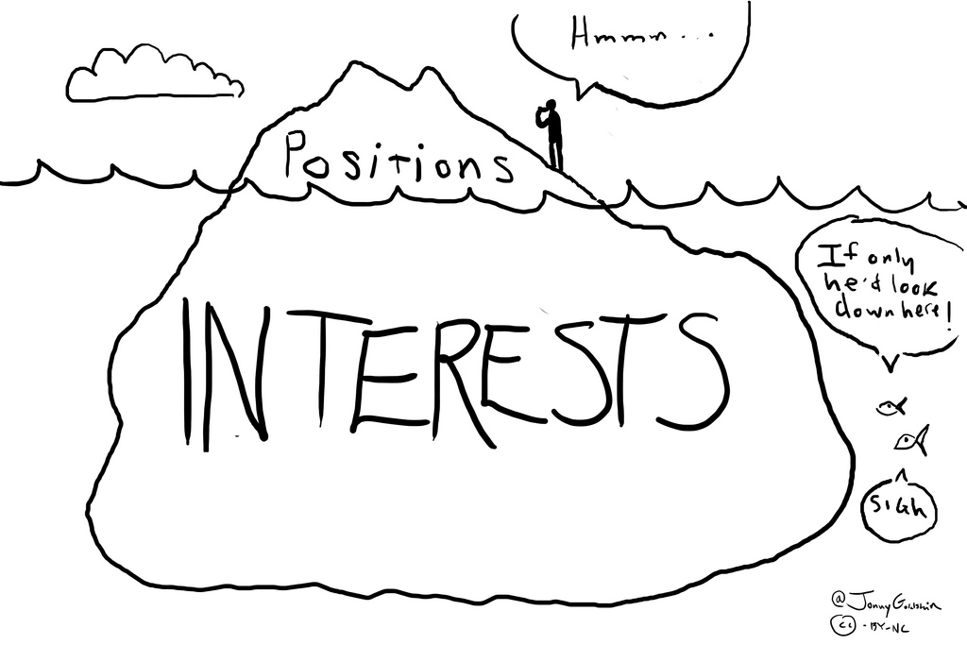
Probing
Notes:
29
SIOR Negotiation Skills

Slide 30
Preparation of Communication Skills
Argument
Persuasion
Reading Body Language
Probing
Listening
Notes:
Rob – in my opinion, this picture is no longer appropriate. Thoughts?
30
SIOR Negotiation Skills

Slide 31
Preparation of Communication Skills
Relating to the Other Negotiator
Be prepared
Proceed with sensitivity
Seek common ground
Understand their wants and needs
Be wary of emotions – mine and theirs
Do you value other stakeholders?
Notes:
31
SIOR Negotiation Skills

Slide 32
Preparation of Communication Skills
Then…
If I…
Don’t want to be around people
Neglect to listen
Don’t offer people help
Ignore people
Am indifferent…
I Don’t Value People
From How Successful People Think by John C. Maxwell
Notes:
32
SIOR Negotiation Skills

Slide 33
Preparation of Communication Skills
Then…
If I…
Want to spend time with people
Listen to people
Want to help people
Am influenced by people
Respect people
I Value People
From How Successful People Think by John C. Maxwell
Notes:
33
SIOR Negotiation Skills

Slide 34
Preparation of Attitude
Mine:
Attitude toward others
Your self-evaluation
Difficult? Proving something?
Which is mine: selfish or selfless?
Other Negotiator:
Background of the decision maker
Personality of decision maker
Difficult? Proving something?
Notes:
34
SIOR Negotiation Skills

Slide 35



Preparation B: Critical Variables
During the Negotiating Process
Recognize the hand you’re dealt
Make the best lemonade from the lemons you have
Here are 3 critical variables:
  Power
  Time
  Information

Slide 36
Critical Variable: Power
COMPETITION
Leverage, Leverage, Leverage!
You need alternative building choices and tenants
BATNA

Slide 37
Critical Variable: Power
BATNA
Best Alternative To a Negotiated Agreement
Defined as the “if the wheels fall off the cart” plan; that is, if negotiation fails for any reason, then this is the solution we’re willing to accept.
The process is as follows:
  Develop a list of criteria on which the decision is being made.
  Determine your BATNA for each item.
  Utilize this tool as needed.
Take in to consideration: cost, feasibility and consequences.
Improve weak BATNA position by:
  brainstorming
  creativity
  experts who may not currently be on the team.
Roger Fisher and William Ury in “Yes: Getting to Yes: Negotiating Without Giving In”, 1981;
also credit goes to Nobel Laureate John Forbes Nash with undergraduate research
Notes:
37
SIOR Negotiation Skills

Slide 38
Notes:
38
SIOR Negotiation Skills

Slide 39
Critical Variable: Power
LEGITIMACY
True authority
Can be confused with:
Perceived authority
Imagined authority
Notes:
39
SIOR Negotiation Skills

Slide 40
Critical Variable: Power
RISK TAKING
The keys to success in risk taking are:
Be willing to walk
Willing for negotiations to be unsuccessful
How?
Be patient
Without spite
AND…
Notes:
40
SIOR Negotiation Skills

Slide 41
Critical Variable: Power
COMMITMENT
With commitment, it is easier to make an amicable deal.
How?
Communicate your position point by point
Obtain commitments on each point
Notes:
41
Instructor’s Note: Ask the question. “When we reconvene to finish our negotiation, what will have to happened today in order for you to feel really good about our progress?”
SIOR Negotiation Skills

Slide 42
Critical Variable: Power
EXPERTISE
Establish expertise with:
3rd party experts
Documentation
How?
Be humble

Slide 43
Critical Variable: Power
INVESTMENT
Invest in the asset you are negotiating.
How?
Acquire knowledge
Commit team resources
Spend money
Notes:
43
SIOR Negotiation Skills

Slide 44
Critical Variable: Power
IDENTIFICATION
If they believe you identify with them
Being on the same team
How?
Agree with other stakeholder
Disagree with other stakeholder
Notes:
44
SIOR Negotiation Skills

Slide 45
Critical Variable: Power
PRECEDENT AND PERSISTENCE
We’ve always done it this way
Persistence
“Nothing in this world can take the place of
persistence.
Talent will not; nothing is more common than unsuccessful people with talent. Genius will not; unrewarded genius is almost a proverb. Education will not; the world is full of educated failures.
Persistence
and determination alone are omnipotent.” – Calvin Coolidge
Notes:
45
SIOR Negotiation Skills

Slide 46
Critical Variable: Power
POWER OF PERSUASION
Tools of persuasion:
Logic
  Have facts and be practical
Emotions
  Positive
  Negative
Mediate
Monetary Gains
Seek to understand the other side

Slide 47
Critical Variable: Power
ATTITUDE
It takes the right combination of attitudes.
Have a winning attitude
Do not seem hungry or desperate
Have “win some” attitude
Be able to recognize their attitude.
If their attitude is negative, then remember, “it’s just a game.”
Notes:
47
SIOR Negotiation Skills

Slide 48

Critical Variable: Power
SILENCE
Can be powerful because it may:
Keep them talking
Help you learn motives
Help you gain information and knowledge
How?
Probe and hush

Slide 49

Critical Variable: Power
MOMENTUM
The process is flowing
It has fluidity
Things come together quickly
Creativity seems to be abundant
How?
Keep engaging
Redefine goals and objectives as necessary
Momentum happens
Notes:
Instructor’s Note: “Fat Albert”

Slide 50

Time Used as a Negotiating Tool:
The “Game Changer”
Different Power Strategy
Time is a continuum
No Beginning
You are always negotiating

Slide 51

Time is a Continuum
Take Your Time
Time Can Be Advantage
Time Limits
Be Credible

Slide 52
Time as a Deadline
Whose deadline?
It is real or imagined?
Make your own deadline
Use proposals for evolving solutions

Slide 53

Time as a Tool
Leave yourself room
Patience Pays
Beware of foot dragging
Problems?
Probe
Concessions

Slide 54
Face to Face Meeting
What are the factors to consider?
What message does your choice send?
Housekeeping?
Notes:
54
SIOR Negotiation Skills

Slide 55

Face to Face Meeting
Where do we meet and why?
Your office
Neutral place
Lessor’s office
Lessee’s office
Country Club
Favorite Restaurant
Notes:
55
SIOR Negotiation Skills

Slide 56
Face to Face Meeting
Factors to Consider
Time of Day
  AM vs. PM?
Choose your seat carefully
  Head of table
  Facing door or window
  Next to opponent or client
Who will attend? What are the roles of each attendee?
Notes:
56
SIOR Negotiation Skills

Slide 57
Face to Face Meeting
Factors to Consider
“He/She who controls the agenda, controls the meeting.”
What is/are the goal(s) for the meeting?
Notes:
57
SIOR Negotiation Skills

Slide 58
Face to Face Meeting
Prepare the Room
Coffee
Pens
Paper
WiFi
Technology needs
Notes:
58
SIOR Negotiation Skills

Slide 59
Face to Face Meeting
Housekeeping
Be on time = early!!
Dress appropriately: over, under or equal?
Everyone is there for a reason!
Notes:
59
SIOR Negotiation Skills

Slide 60
Powerful Negotiating Strategies
ANCHORING AND PIE-SHARING

Slide 61

Powerful Negotiating Strategies
THE SILENT TREATMENT

Slide 62
Powerful Negotiating Strategies
LOW-BALLING/ANCHORING

Slide 63

Powerful Negotiating Strategies
POWER OF PRINT

Slide 64
Powerful Negotiating Strategies
TIME: LAST MINUTE

Slide 65
Powerful Negotiating Strategies
GOOD GUY/BAD GUY

Slide 66
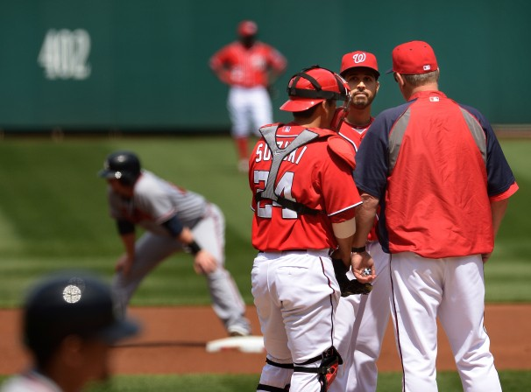
Powerful Negotiating Strategies
MY MANAGEMENT

Slide 67
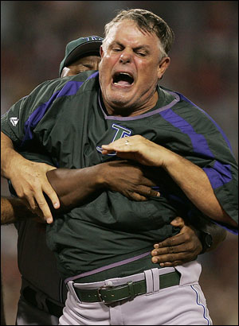

Slide 68

Powerful Negotiating Strategies
LEAVING MONEY ON THE TABLE

Slide 69

Powerful Negotiating Strategies
FAIT ACCOMPLI

Slide 70
Powerful Negotiating Strategies
APPEAR
UNREASONABLE

Slide 71

Powerful Negotiating Strategies
CLARIFICATION OF POSITION

Slide 72

Powerful Negotiating Strategies
LISTING THE PROS AND CONS

Slide 73

Powerful Negotiating Strategies
THE POWER OF GUILT

Slide 74

Powerful Negotiating Strategies
STRAW TIGER ISSUES

Slide 75

Powerful Negotiating Strategies
RED HERRING

Slide 76

Powerful Negotiating Strategies
SUMMARIES OF FACTS,
STATEMENTS,
AND AGREEMENTS

Slide 77

Powerful Negotiating Strategies
RECESSES AND
ADJOURNMENTS

Slide 78

Powerful Negotiating Strategies
CHANGING NEGOTIATORS IN MID-DEAL

Slide 79
Powerful Negotiating Strategies
CONCILIATORY MOVES
CONCESSIONS
SPICE AND DRAMA

Slide 80

Powerful Negotiating Strategies
THREATS –ULTIMATUMS AND INTIMIDATION

Slide 81
Powerful Negotiating Strategies
BLUFFS

Slide 82

Powerful Negotiating Strategies
WALKOUTS – DO NOTHING

Slide 83
Powerful Negotiating Strategies
LEAVING GRACEFULLY IF NO DEAL: BATNA

Slide 84
Powerful Negotiating Strategies
NEGATIVE SALESMANSHIP

Slide 85
Powerful Negotiating Strategies
SPLIT DOWN THE MIDDLE / RE-ANCHORING

Slide 86

Powerful Negotiating Strategies
IT’S TOO COMPLICATED – LET’S MAKE IT SIMPLE

Slide 87
Powerful Negotiating Strategies
Alternative of Choice Close
Left at the Altar
Making Balloon Futures
Calling in a Higher Authority
Crunch Time
Bring in the Dancer
Re-Trading the Deal

Slide 88
Powerful Negotiating Strategies
Huntley and Brinkley
Turning Soviet
Roaring Brains
Needs vs. Wants Matrix

Slide 89
Unselfish Thinking Makes You Part of Something Greater than Yourself
“We try never to forget that medicine is for the people. It is not for the profits. The profits follow, and if we have remembered that, they have never failed to appear.” – George W. Merck
The lesson to be learned? Simple.
Instead of trying to be great, be part of something greater than yourself.
From How Successful People Think by John C. Maxwell
Notes:
89
SIOR Negotiation Skills

Slide 90
Exhibits
Notes:
90
SIOR Negotiation Skills

Slide 91
Exhibit A
 |  | Is the Substantive Outcome Very Important?
 |  | YES | NO
Is the Relationship Outcome Very Important? | YES | TRUSTINGLY COLLABORATE | OPENLY SUBORDINATE
 | NO | FIRMLY COMPETE | ACTIVELY AVOID NEGOTIATING
Notes:
91
SIOR Negotiation Skills

Slide 92
Exhibit B
Concern for Substance | High
 | Moderate
 | Low
Defeat
Be a winner
at any cost.
Collaborate
Creatively problem
solve so both
parties win
Compromise
Split the difference
Take whatever
you can get
Withdraw
Build friendly
relationships.
Accommodate
Low | Moderate | High
Concern for Relationship
Notes:
92
SIOR Negotiation Skills

Slide 93
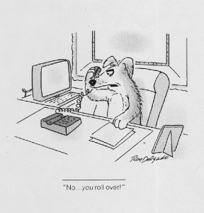
Exhibit C
Notes:
93
SIOR Negotiation Skills

Slide 94

THANK YOU, SIOR STUDENTS!!
William A. Burgess, CCIM, SIOR
The Burgess Company, LLC
Greenville, SC

